Slide 1
Traffic Racer Computer graphics project
SUPERVISOR:
ENG. YAHIA ETMAN

Slide 2
WORK LOAD
KARIM SAQER. SEC:2 B:9 code: 9204096
KARIM MOHAMED. SEC:2 B:8 code: 9203074
PHASE 1:
MESH
TRANSFORM
FORWARD RENDERER SYSTEM
SKY RENDERING
POSTPROCESSING
PHASE 2:
LIGHTING SYSETEM
INTEGRATE LIGHTING WITH COMPONENTS
COLLISION SYSTEM
MAIN MENU STATE
GAME-OVER MENU STATE
NEW POSTPROCESSING

Slide 3
WORK LOAD
Khaled Mostafa. SEC:1 B:21 code: 9202511
Abdelrahman Ashraf. SEC:1 B:35 code: 9202769
PHASE 1:
Shader
Pipeline State
Texture
Sampler
Material
Entities and Components
PHASE 2:
Score and its logic
Car movement
Breaking
Randomness of the cars
Infinity render of the roads and lamp poles
Render the components
Integration speed and time with score
Integrate new postprocessing with game

Slide 4


Slide 5
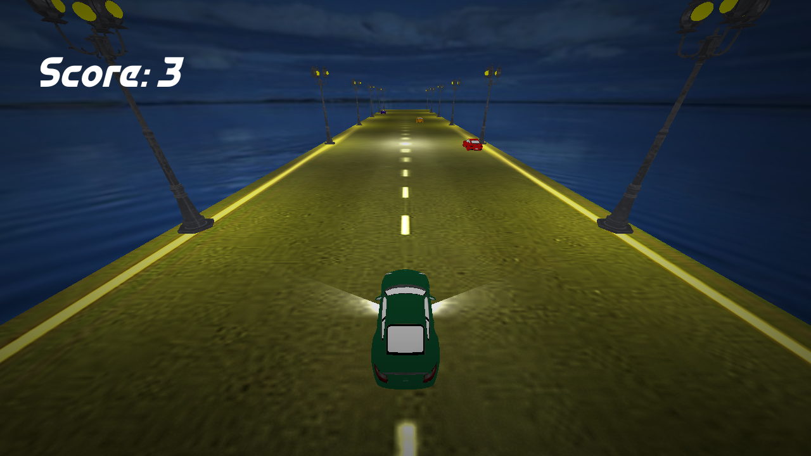

Slide 6
